Slide 1




Deep Learning Final Project
TOPIC2:Drug Repositioning Dataset
Group 5
group member:
洪幸宇
王詠盛
林楷祐
吳柏翰

Slide 2


Outline
Introduction
Results
Methods
Conclusion

Slide 3


Introduction

Slide 4
Introduction
In the drug repositioning dataset we are using, it is mainly divided into three section.
diseaseInfo:This section contains over 1,500 diseases identified by MeSH IDs, providing a description, associated pathways, and classification group information for each disease.
drugsInfo:This section contains approximately 1,400 drugs identified by DrugBank IDs, providing information on drug descriptions, targets, pharmacodynamics, SMILES notation, mechanisms of action, treated conditions, and categories.
mapping:This section contains known drug interactions and disease interactions.

Slide 5
Motivation
We referenced the research paper:
"Predicting potential microbe–disease associations based on multi-source features and deep learning"
(Liugen W et al.,2023)
microbe-disease associations.
Based on the methods in this paper, we plan to modify the prediction of microbe-disease associations to disease-drug predictions.

Slide 6
Method

Slide 7
Method
In the referenced paper,some similarity calculation methods were used to quantify the association between diseases and drugs.
Diseases semantic similarity:Used to measure the similarity between diseases.
Microbes functional similarity:Used to measure the similarity between microbes.
Cosine Similarity:Calculate the cosine of the angle between two vectors to measure their degree of association.
Gaussian interaction profile kernel Similarity:Calculate the similarity between microbes and diseases.
Sigmoid Kernel Function Similarity:Calculate the similarity between microbes and diseases.
Notes:
疾病語義相似性 (Disease Semantic Similarity, DS): 用於衡量疾病之間的相似程度。 這種相似性是基於疾病的語義資訊，可以捕捉疾病之間在生物學意義上的關聯。
微生物功能相似性 (Microbe Functional Similarity, F_MS): 用於衡量微生物之間的功能相似程度。 這種相似性是基於微生物的生物學功能，可以幫助識別功能相似的微生物。
餘弦相似性 (Cosine Similarity, COS_MS, COS_DS): 根據已知的微生物-疾病關聯資訊，計算微生物和疾病之間的相似性。 餘弦相似性可以衡量兩個向量之間的夾角餘弦值，從而反映它們之間的相似程度。
高斯交互作用剖面核相似性 (Gaussian Interaction Profile kernel similarity, GIP_MS, GIP_DS): 基於已知的微生物-疾病關聯資訊，計算微生物和疾病之間的相似性。 GIP 相似性可以捕捉微生物和疾病之間基於關聯資訊的相似性。
Sigmoid 核函數相似性 (Sigmoid kernel function similarity, SIG_MS, SIG_DS): 基於已知的微生物-疾病關聯資訊，計算微生物和疾病之間的相似性。 Sigmoid 核函數相似性可以捕捉微生物和疾病之間非線性的相似性關係。

Slide 8
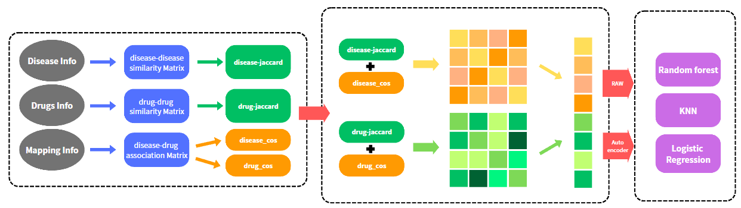
Architecture
我是王詠盛
Notes:
Based on the aforementioned study, we have developed an improved model, which is divided into two main parts. The first part involves generating matrices, while the second part focuses on combining these matrices to form features that are fed into the model for prediction.

Slide 9
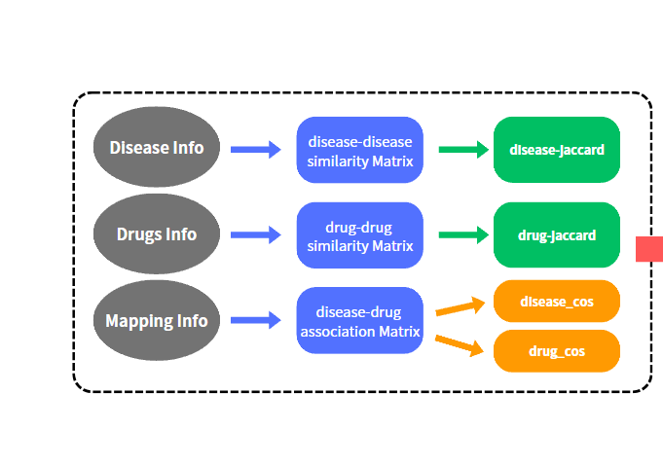
Architecture
Notes:
Now, let’s take a look at the first part. First, we calculate the similarity between the Disease dataset and the Drug dataset and use the Mapping Information to compute the Association Matrix, represented by the blue squares in the diagram. Next, we calculate the Jaccard similarity for the two similarity matrices and compute the Cosine Similarity for the disease-drug association matrix, resulting in the Disease-Drug Cosine Similarity. At the end of this step, we obtain four matrices: the Disease Jaccard Similarity Matrix, the Drug Jaccard Similarity Matrix, the Disease Cosine Similarity Matrix, and the Drug Cosine Similarity

Slide 10
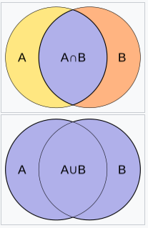

Jaccard Similarity Coefficient
In our method, we use Jaccard Similarity Coefficient to calculate the similarity between diseases and drugs.
Jaccard Similarity Coefficient : It is an indicator used to measure the similarity between two sets, suitable for analyzing finite sample sets.
Notes:
Let me explain jaccard similarity here.

Slide 11


Cosine Similarity
Cosine similarity is a method used to measure the similarity of the angle between two vectors. It is often used to calculate the similarity between two objects, such as microorganisms or diseases.
Cosine similarity does not consider the length of the vectors; it only focuses on the angle between them.
If the directions (angles) of two vectors are very close, their cosine similarity approaches 1, indicating that they are highly similar.On the contrary, it approaches 0.
Notes:
Let me explain Cosine Similarity here.

Slide 12
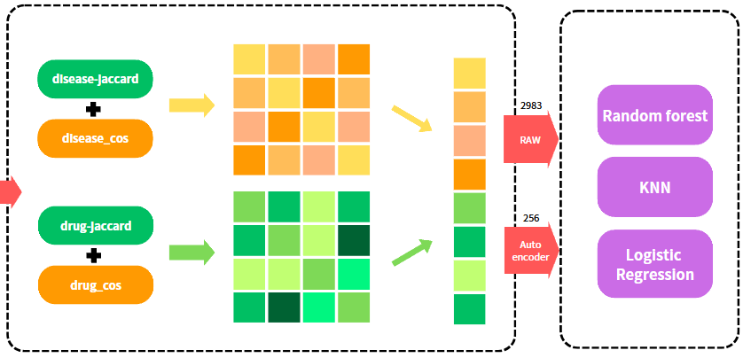
Architecture
Random generation to create negative samples and combine them with positive samples to construct the feature set.
Notes:
Next is the second part. We take the two matrices related to diseases and the two matrices related to drugs from the previous step, average each pair by adding them and dividing by two, and then concatenate them to form the input features for our model. Based on the mapping information, we pair the data to generate positive samples. Negative samples are created using random generation. The positive and negative samples are then combined and split into training and testing sets in an 8:2 ratio. These features are processed through an autoencoder to reduce their dimensionality to 256 dimensions. Additionally, we directly use the nearly 3000-dimensional features without dimensionality reduction. Both sets of features are evaluated using three models—Random Forest, KNN, and Logistic Regression—to compare the results.

Slide 13
Method
We used the dimensionally reduced features and raw features as input for classification.
And we tried to use three classifiers for classification:
Random Forest
KNN
Logistic Regression

Slide 14
Result
Notes:
Now it's my turn to present the results.

Slide 15
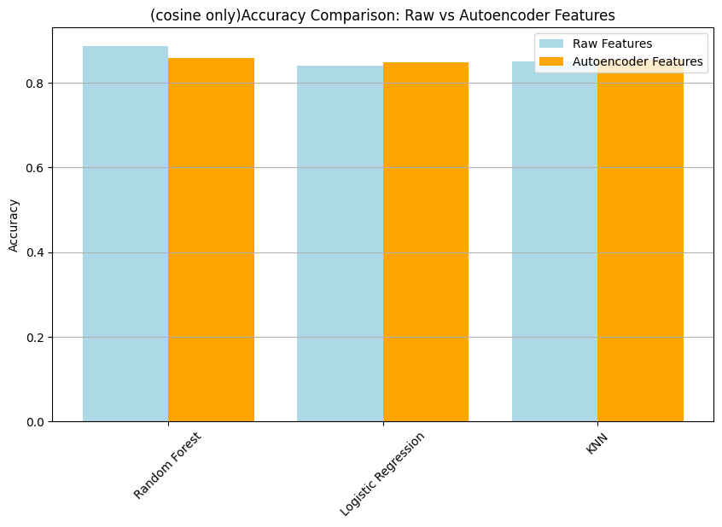
cosine only result
Accuracy
Notes:
First, I will introduce the results when using only Cosine Similarity.
Based on the three classification methods mentioned earlier, we will obtain a result for each method.
Each result will be divided into those using raw features and those using features processed by the autoencoder.
The first evaluation metric is accuracy.
The first is processed through Random Forest, the second through Logistic Regression, and the third through KNN.
The result of using raw features processed through Random Forest is 0.886.
The result of using autoencoder features processed through Random Forest is 0.8581.
The same applies to the subsequent results.

Slide 16
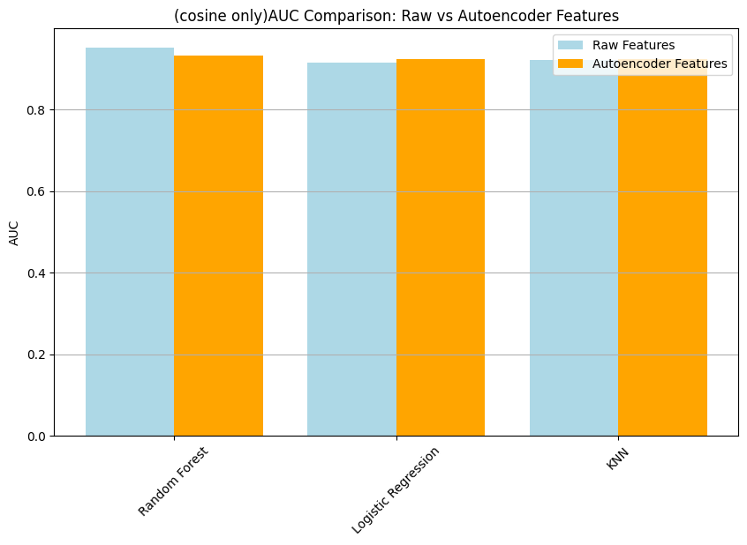
cosine only result
AUC
Notes:
The second evaluation metric is auc.
The result of using raw features processed through Random Forest is 0.9505
The result of using autoencoder features processed through Random Forest is 0.9319
The same applies to the subsequent results.

Slide 17
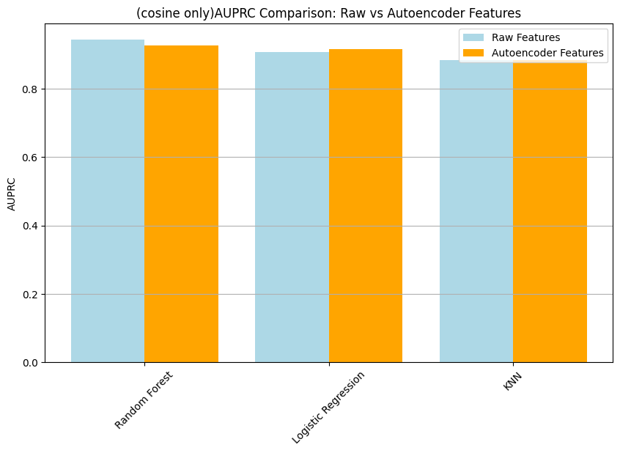
cosine only result
AUPRC
Notes:
The third evaluation metric is auprc.
The result of using raw features processed through Random Forest is 0.9433
The result of using autoencoder features processed through Random Forest is 0.9260
The same applies to the subsequent results.

Slide 18
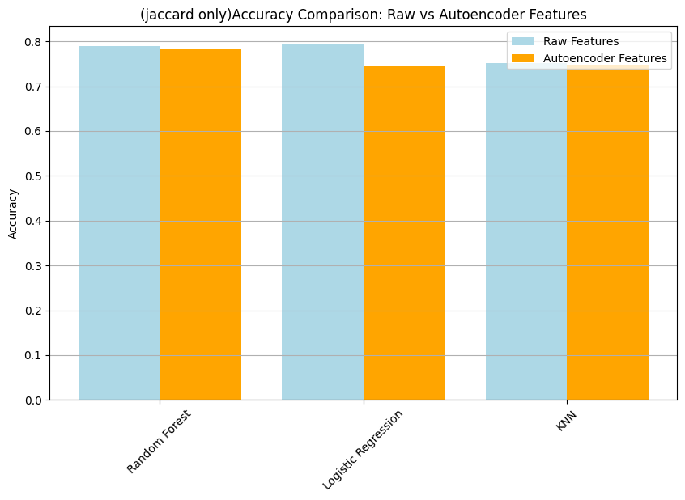
jaccard only result
Accuracy
Notes:
Next are the results using only Jaccard Similarity.
The observations are exactly the same as before.
The first evaluation metric is accuracy.
The result of using raw features processed through Random Forest is 0.7890
The result of using autoencoder features processed through Random Forest is 0.7815
The same applies to the subsequent results.

Slide 19
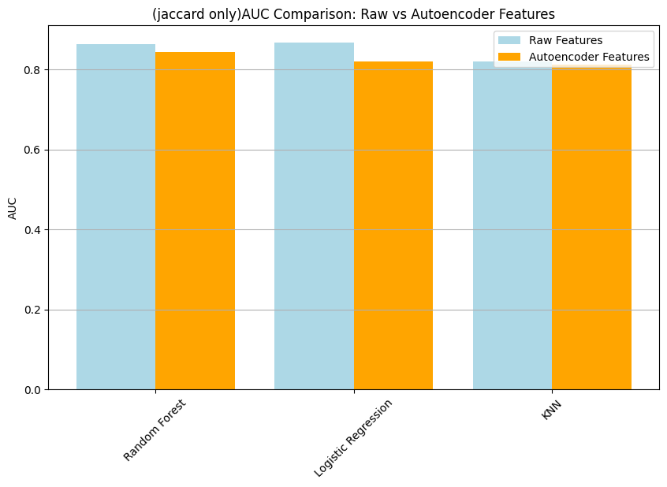
jaccard only result
AUC
Notes:
The second evaluation metric is auc.
The result of using raw features processed through Random Forest is 0.8633
The result of using autoencoder features processed through Random Forest is 0.8448
The same applies to the subsequent results.

Slide 20
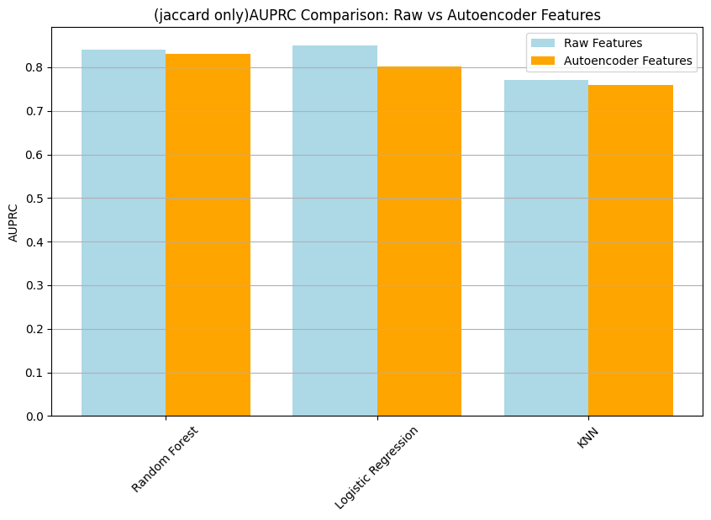
jaccard only result
AUPRC
Notes:
The third evaluation metric is auprc.
The result of using raw features processed through Random Forest is 0.8405
The result of using autoencoder features processed through Random Forest is 0.8304
The same applies to the subsequent results.

Slide 21
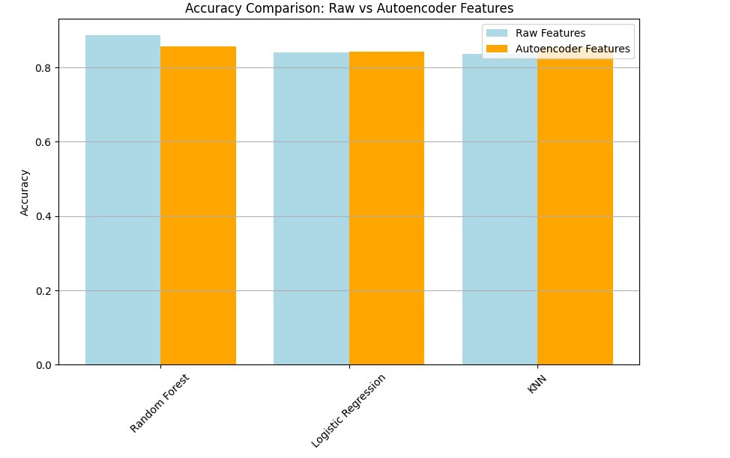
Combined Similarity Result
Accuracy
Notes:
Finally, we observe the results when using both types of similarity simultaneously.
The first evaluation metric is accuracy.

Slide 22
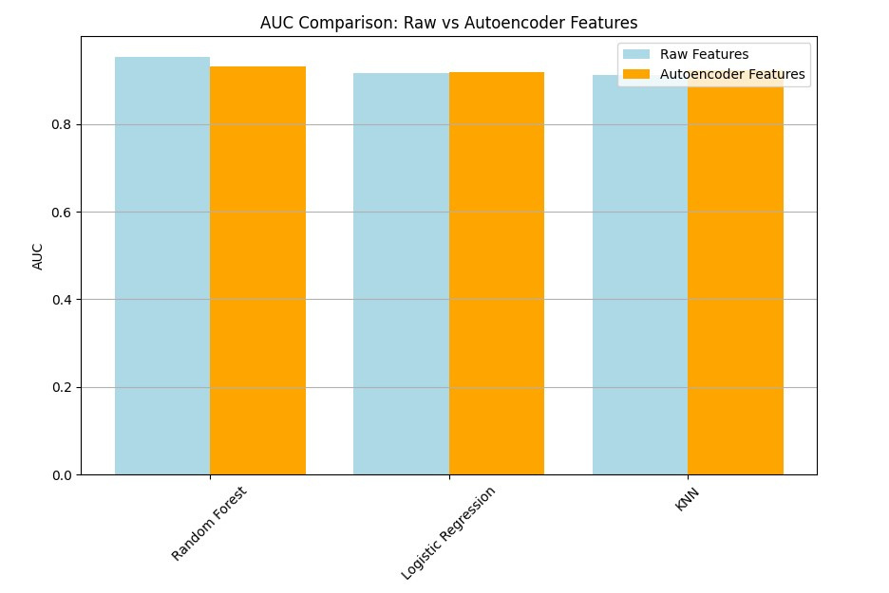
Combined Similarity Result
AUC
Notes:
The second evaluation metric is auc.

Slide 23
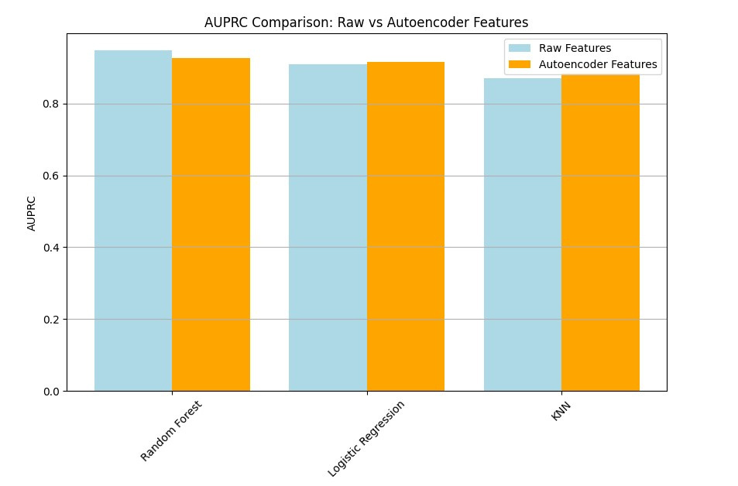
Combined Similarity Result
AUPRC
Notes:
The third evaluation metric is auprc.

Slide 24
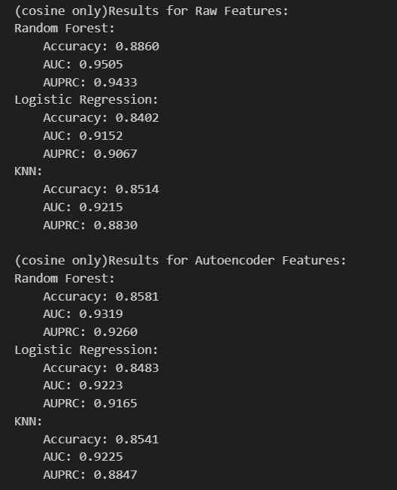
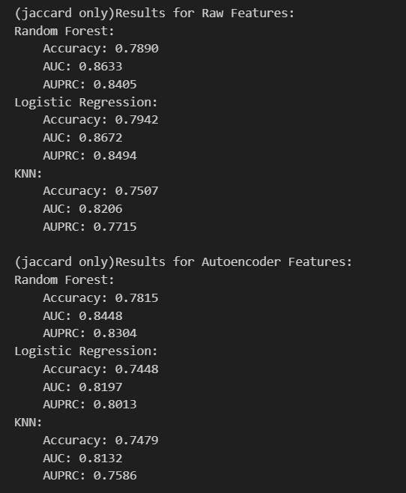
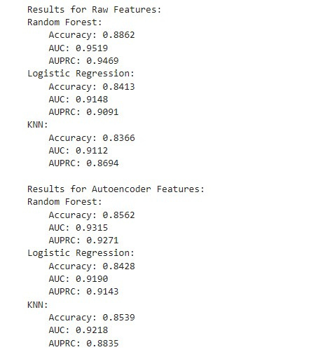
All Result
cosine Similarity
jaccard Similarity
Combined Similarity
Notes:
From this data table, we can see that the results using only Cosine Similarity are better than those using only Jaccard Similarity. In fact, the results using only Cosine Similarity are almost similar to those using Combined Similarity.
Additionally, the results using raw features are generally better than those using autoencoder features.

Slide 25
Conclusion

Slide 26
Conclusion
Why does using features processed by an autoencoder for classification perform worse than using raw features?
Why are only two methods used to calculate similarity?
Why are the results using only Cosine Similarity better than those using only Jaccard Similarity?
The results show that using Random Forest as the classifier yields the best performance.
Notes:
We believe that during the dimensionality reduction process, some important features were also eliminated because our dataset is significantly different from the dataset used in the paper.This led to the results using raw features being better.
Because the similarity calculation method proposed in the paper is too difficult and complex, it is not easy to implement。Therefore, we chose a simpler method to implement, and the results turned out to be better than expected.
When the data consists of weighted vectors or high-dimensional sparse data, Cosine Similarity performs better because it focuses on the direction of the vectors rather than the overlap of their elements.Therefore, this is likely the main reason.

Slide 27
Future Work
Attempt to use the complete method proposed in the paper.
Adjust the number of layers and dimensions of the autoencoder until the results outperform those using raw features.
Try referring to methods from other research papers.

Slide 28
Thank You For WATCHing!
See You Next Time!

